Slide 1
Matching of 1A station
Machine learning hands-on approach for matching two sets of data
Notes:
Кто я.
Почему я компетентен это рассказать.
Какую задачу решаем.

Slide 2
Meet the data
UIC | Country | Name | Lon | Lat
8764342 | FR | ORSCHWILLER CHAPELLE | 481655N | 072155E
80G2274 | DE | Grüna(Sachs) Haltestelle | 504841N | 124754E
8322082 | IT | Pontemaglio | 461049N | 081924E
8301111 | IT | Colmegna | 460123N | 084521E
~14000 stations 1A/SNCF
Notes:
Describe data
Columns
Values

Slide 3
Existing approach
Source | UIC | Country | Name | Lon | Lat
1A | 8716819 | FR | AUCH ZA LAMOTHE | 434144N | 003651E
SNCF | 8770072 | FR | Lamothe Goas | 434144N | 003651E
Source | UIC | Country | Name | Lon | Lat
1A | 80G0219 | DE | Heilbronn Harmonie/Hafenmarktpassage | 490834N | 091321E
SNCF | 8071172 | DE | Heilbronn Harmonie/Hafenmarkt | 490833N | 091320E
Notes:
Describe existing approach:
Match of substring
Match of UICs

Slide 4
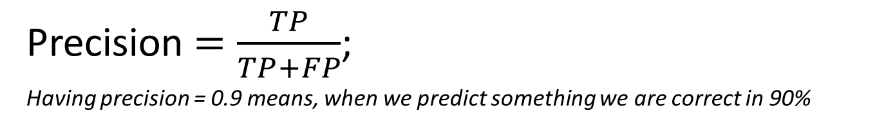
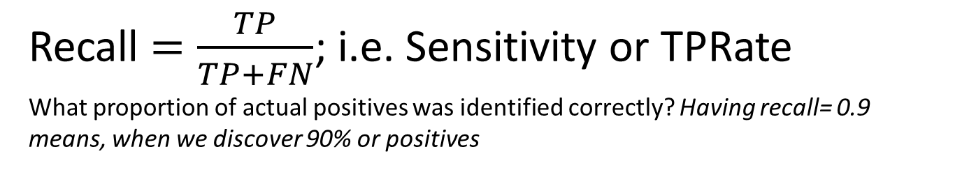
How to measure quality
Confusion matrix
True Negative | False Positive
False Negative | True Positive
Precision $=\frac{TP}{TP+FP}$;
Having precision = 0.9 means, when we predict something we are correct in 90%
Recall $=\frac{TP}{TP+FN}$; i.e. Sensitivity or TPRate
What proportion of actual positives was identified correctly? Having recall= 0.9 means, when we discover 90% or positives
Notes:
General approach is Accuracy.
But more appropriate to use Confusion matrix
- Tell about CM: Для задач классификации используется СМ, 2x2 матрица, где мы пишем результаты нашего классификатора
Tell about precision
Tell about Recall
Precision/Recall, пример с отпуском и загаром

Slide 5
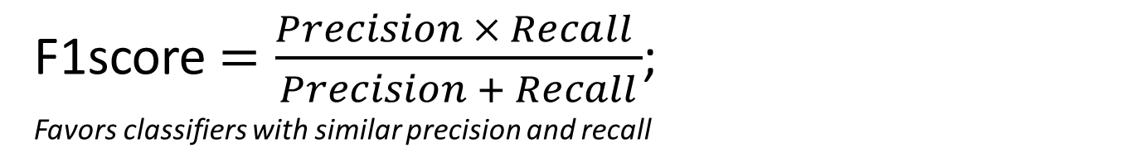
How to measure quality
Confusion matrix
True Negative | False Positive
False Negative | True Positive
F1score$=\frac{Precision × Recall }{Precision + Recall}$;
Favors classifiers with similar precision and recall
Notes:
F1 – гармоническое среднее P/R. Оценка выше для сбалансированных классификаторов.

Slide 6
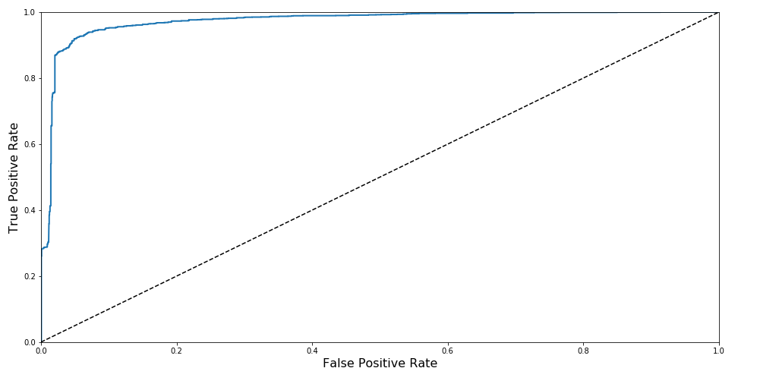
How to measure quality
Area Under Curve
Notes:
Area Under Curve – интеграл.
эквивалентна вероятности, что классификатор присвоит больший вес случайно выбранной положительной сущности, чем случайно выбранной отрицательной
ROC применяют когда датасет не skewed (balanced)

Slide 7
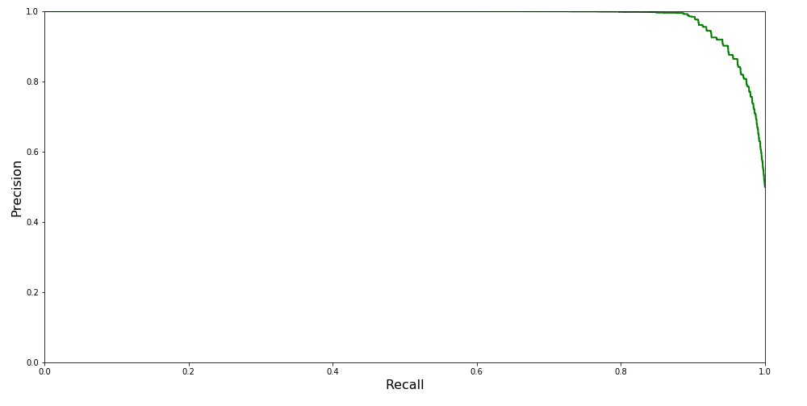
Precision/Recall tradeoff
Brave or scared classifier
Notes:
P/R – используется когда позитивный экземпляр редок.
Визуально понятно, что P/R балансируем (выше recall – падает precision)
Испуганный классификатор – детектирует только простые случаи (low recall/high precision)
Храбрый классификатор – ковбой, который стреляет по всему что движется (high recall/low precision)

Slide 8
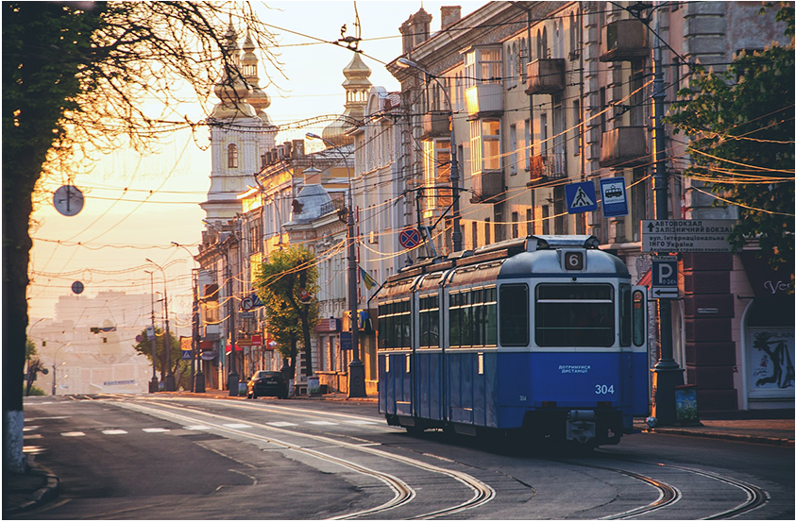
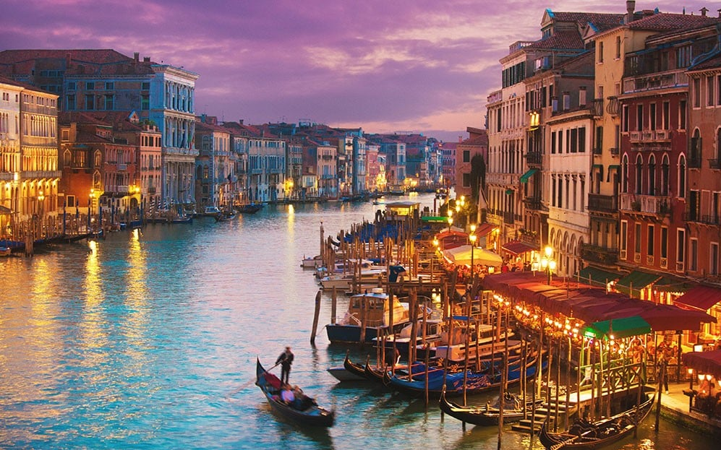
What do we aim for?
Vinica
Venice
Maximize Precision (minimal FP), high Recall
Notes:
Максимальный Precision (минимальный FP), Максимальный Recall

Slide 9
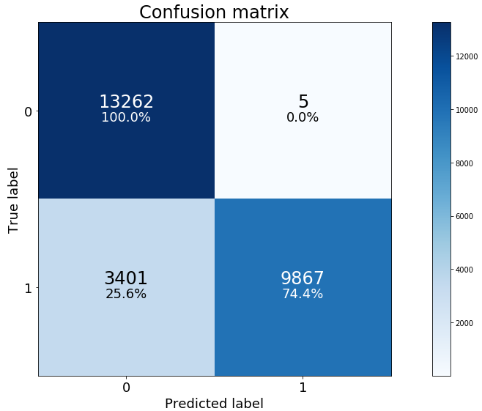
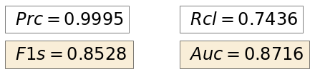
Existing approach quality
Notes:
Describe existing approach:
Low Recall
Excellent Precision

Slide 10




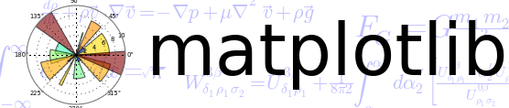
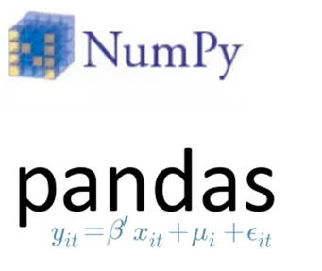
Let’s try to enhance

Slide 11
What to classify
20 000 1A stations
18 000 SNCF stations
Source | UIC | Country | Name | Lon | Lat
1A | 8716819 | FR | AUCH ZA LAMOTHE | 434143N | 003651E
SNCF | 8770072 | FR | Lamothe Goas | 434144N | 003650E
uic_similarity | same_country | name_similarity_score | geo_distance
5 | 1 | 8 | 3 km
Notes:
What to classify?
Build classifier for each station (isVenice classifier)
Build distance vector and classify it
GO TO NOTEBOOK

Slide 12
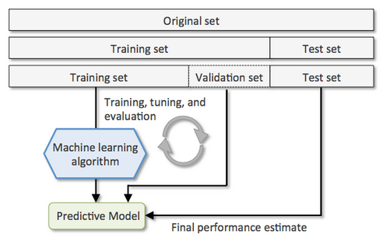
Train, Validate, Test
Notes:
FROM NOTEBOOK

Slide 13
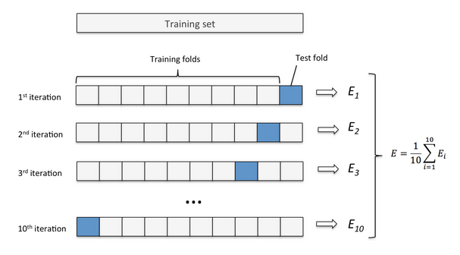
K-Fold Cross Validation
Notes:
GO BACK TO NOTEBOOK

Slide 14


SGDClassifier
regularized linear models with stochastic gradient descent (SGD) learning
Penalty :
L2 - standard regularizer for linear SVM models (Ridge regression)
L1 - leads to sparse solutions, driving most coefficients to zero (Lasso regression)
The key difference between these techniques is that Lasso shrinks the less important feature’s coefficient to zero thus, removing some feature altogether. So, this works well for feature selection in case we have a huge number of features.
Elasticnet - convex combination of L2 and L1
Notes:
regularized – Рассказать про запоминание. Минимизацию функции
Рассказать про гиперпараметры
NN - overkill

Slide 15
SGDClassifier
regularized linear models with stochastic gradient descent (SGD) learning
Loss function:
Log - loss gives logistic regression, a probabilistic classifier
Hinge - (soft-margin) linear Support Vector Machine
Alpha - Constant that multiplies the regularization term
max_iter -maximum number of passes over the training data (aka epochs)
Notes:
regularized – Рассказать про запоминание. Минимизацию функции
Рассказать про гиперпараметры
NN - overkill
След слайд про перетренерованность

Slide 16
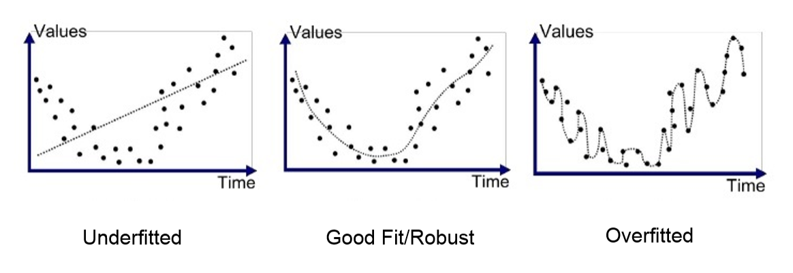
Bias/Variance
Underfitting(High Bias) – Validation and training error high
Overfitting(High Variance) – Validation error is high, training error low
Good fit – Validation error low, slightly higher than the training error
Unknown fit - Validation error low, training error high
Notes:
GO TO NOTEBOOK

Slide 17
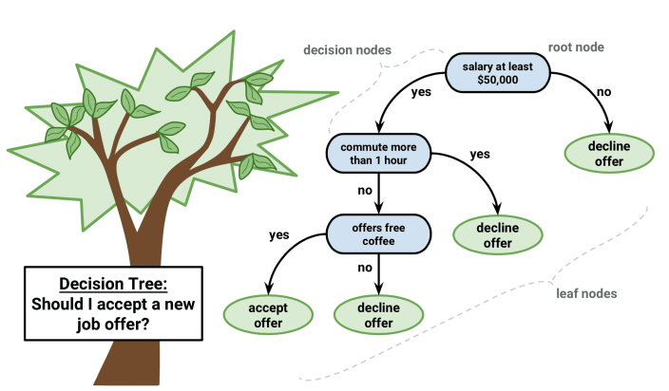
Decision Tree

Slide 18
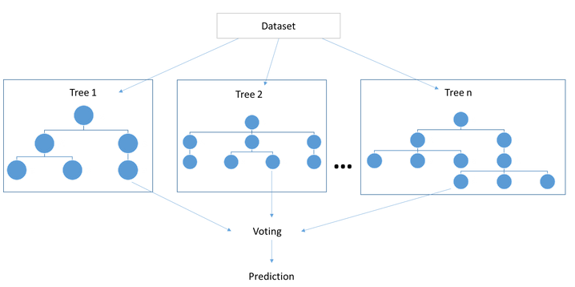
Random Forest Classifier
Ensemble of decision tree classifiers
Split data in overlapping/gaping subsets (based on information gain)
Use only subset of features for each tree
Make ensemble voting

Slide 19
Random Forest Classifier
n_estimators - The number of trees in the forest
criterion:
gini - for the Gini impurity, probability labeling
entropy - for the information gain
max_depth - The maximum depth of the tree
min_samples_split - number of samples required to split an internal node
min_samples_leaf - The minimum number of samples required to be at a leaf node
max_features - size of the random subsets of features to split a node
Lower – reduce variance, higher – increase bias.
Notes:
Gini impurity is a measure of how often a randomly chosen element from the set would be incorrectly labeled if it was randomly labeled according to the distribution of labels in the subset
entropy – Мальчик Коля
if min_samples_split = 5, and there are 7 samples at an internal node, then the split is allowed. But let's say the split results in two leaves, one with 1 sample, and another with 6 samples. If min_samples_leaf = 2, then the split won't be allowed (even if the internal node has 7 samples) because one of the leaves resulted will have less then the minimum number of samples required to be at a leaf node.
min_samples_leaf guarantees a minimum number of samples in every leaf, no matter the value of min_samples_split.

Slide 20
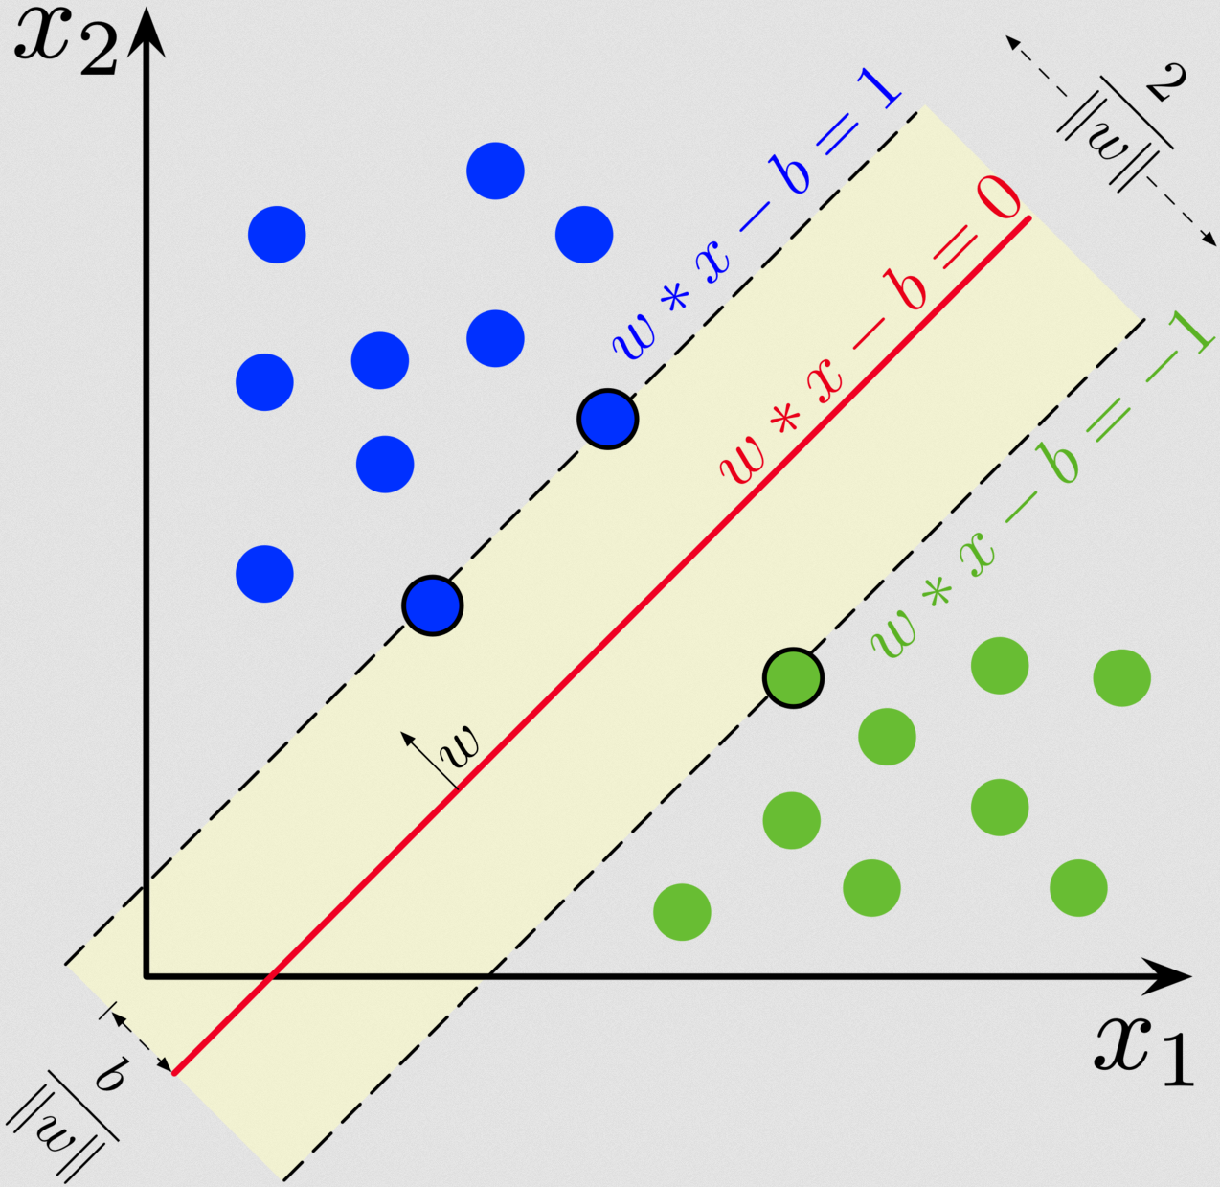
Support Vector Machine
Create hyperplane to separate classes (linearly separable)
Notes:
FROM SLIDE

Slide 21
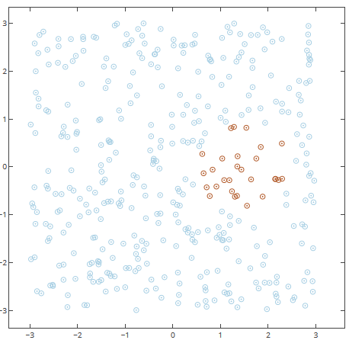
Support Vector Machine
Create hyperplane to separate classes (linearly non separable)
Notes:
Powerful with small datasets.
Have big complexity. Scales bad with datasets above 10000
GO TO Notebook

Slide 22
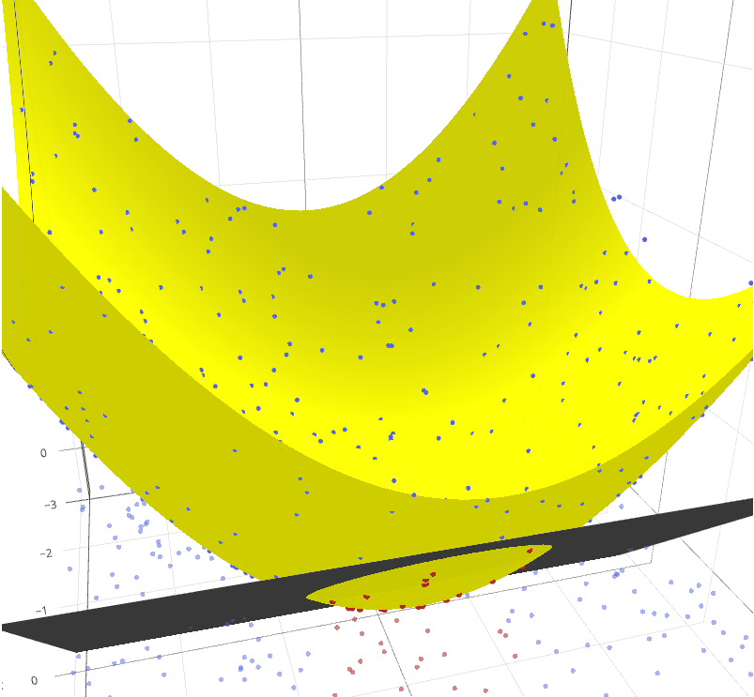
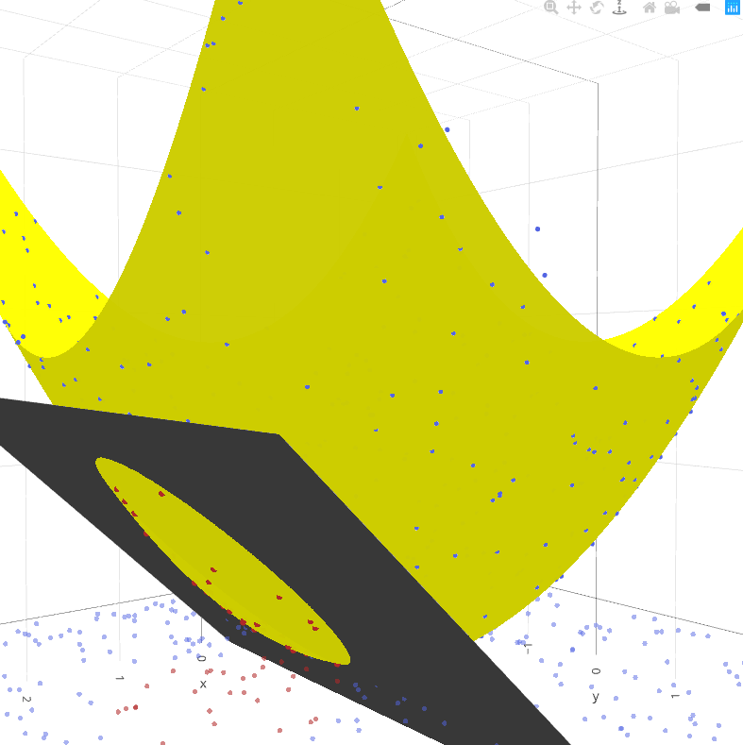
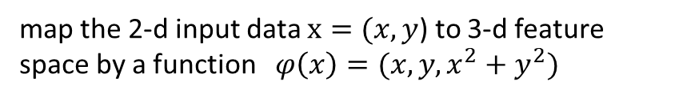
Support Vector Machine
Create hyperplane to separate classes (linearly non separable)
map the 2-d input data $x=(x,y$) to 3-d feature space by a function $φ\left(x\right)=(x,y,x^{2}+y^{2})$
Notes:
Powerful with small datasets.
Have big complexity. Scales bad with datasets above 10000
GO TO Notebook

Slide 23
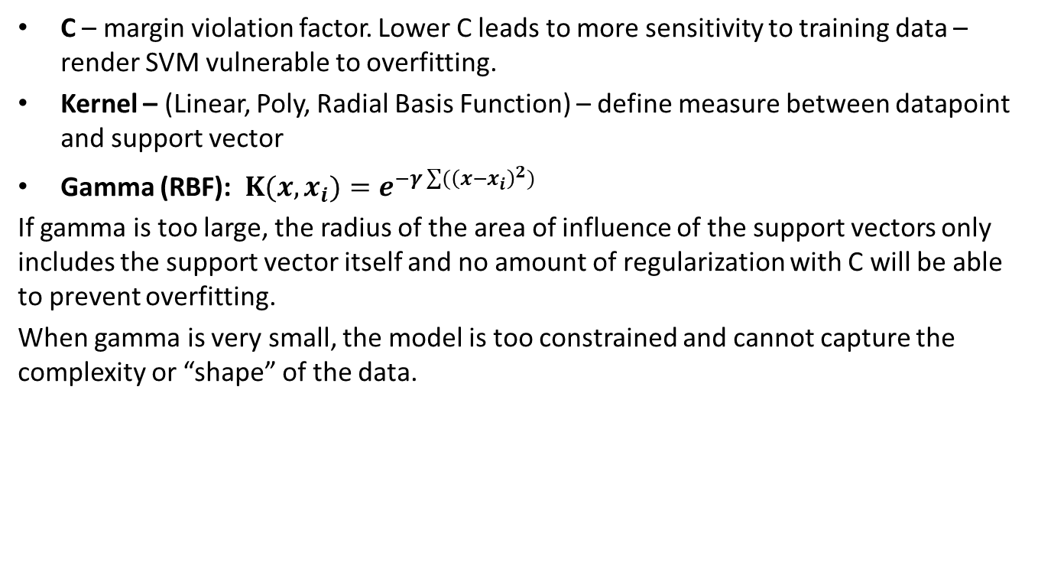
SVM Hyperparameters
C – margin violation factor. Lower C leads to more sensitivity to training data –render SVM vulnerable to overfitting.
Kernel – (Linear, Poly, Radial Basis Function) – define measure between datapoint and support vector
Gamma (RBF): $K(x,x_{i})=e^{−γ\sum{({\left(x−x_{i}\right)}^{2})}}$
If gamma is too large, the radius of the area of influence of the support vectors only includes the support vector itself and no amount of regularization with C will be able to prevent overfitting.
When gamma is very small, the model is too constrained and cannot capture the complexity or “shape” of the data.

